Slide 1
Finding Stories in Data

Slide 2
Contents
The Data Journalism Process
Data sources: recurring events
Exercise
Data sources: sent or leaked data
Data sources: breaking news
Data sources: theories to be explored
Exercise
Summary & References

Slide 3
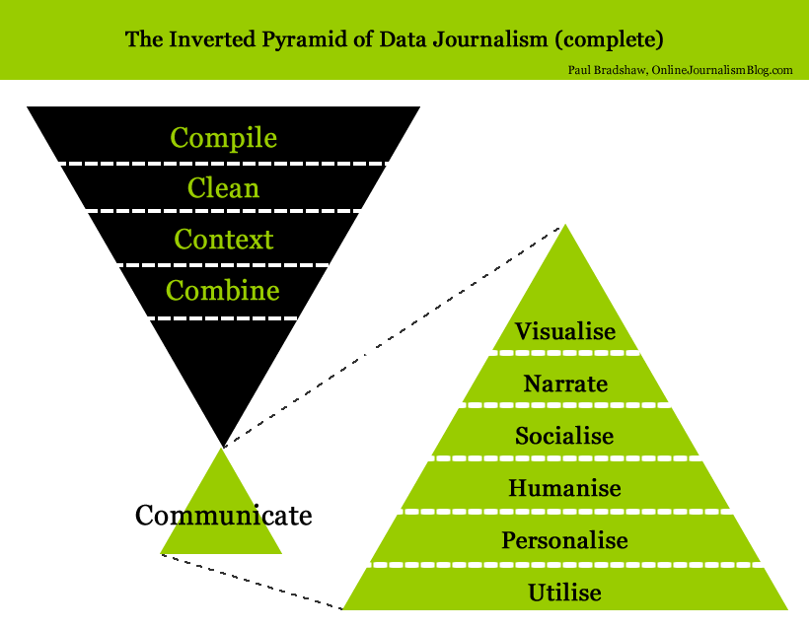
The Data Journalism Process

Slide 4
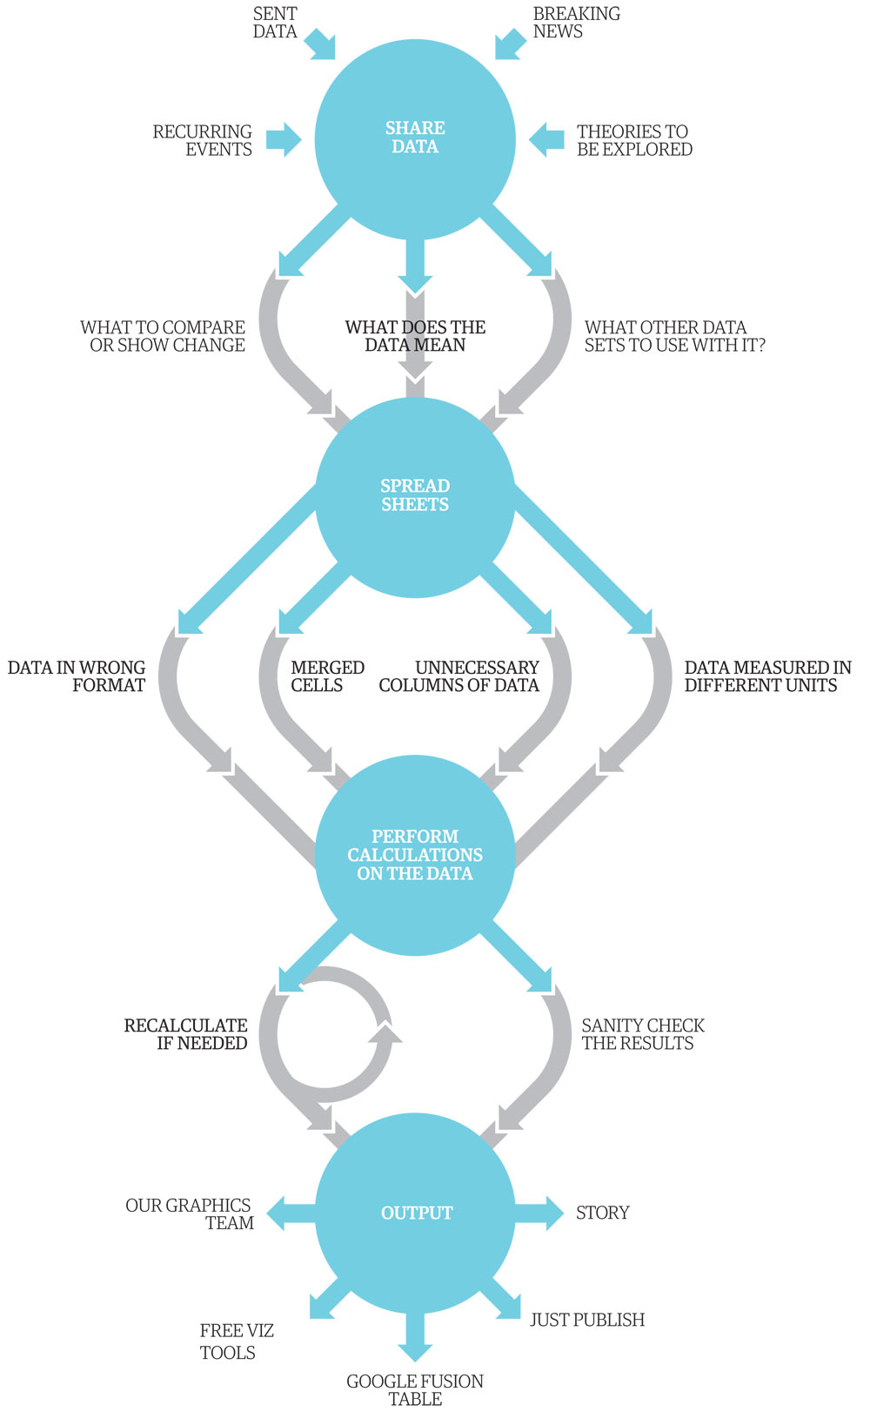
The Data Journalism Process The Guardian: 1. Share Data 2. Spread Sheets 3. Perform Calculations 4. Output

Slide 5
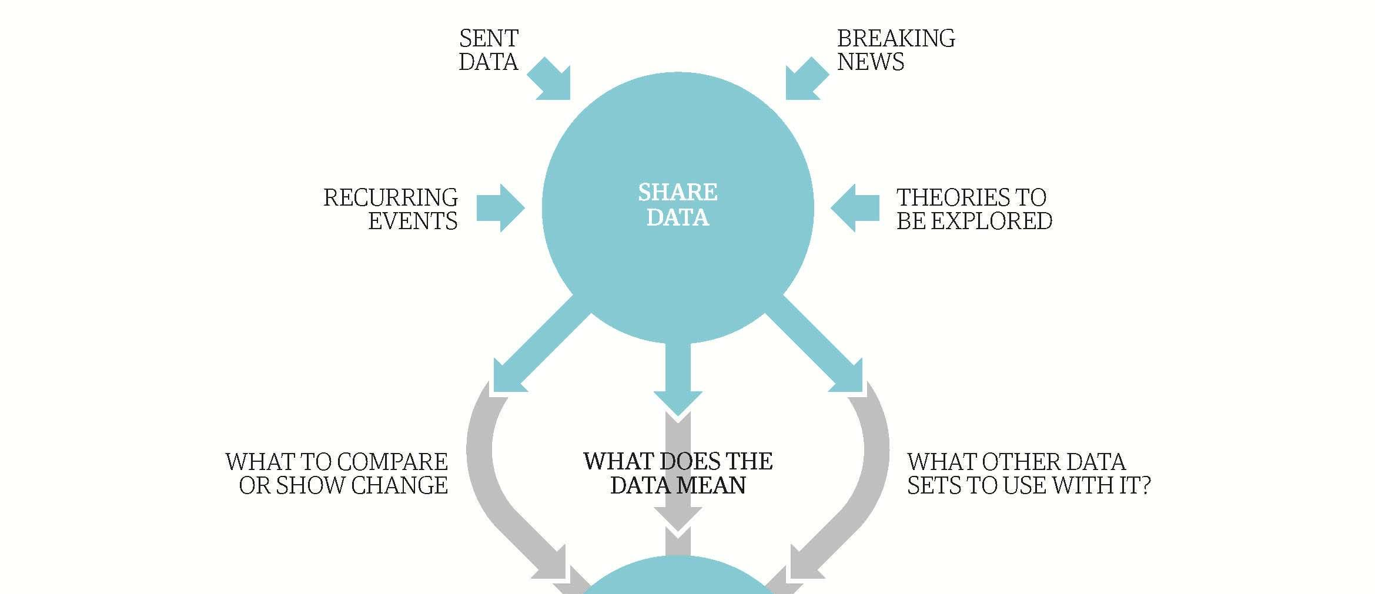
The Data Journalism Process

Slide 6
Data sources
Data sources: recurring events
Data sources: sent or leaked data
Data sources: breaking news
Data sources: theories to be explored

Slide 7
Data sources
Data sources: recurring events
Governance & Security Indicators
Economic Indicators & Budgets
Education Indicators
Human rights & Equality Indicators
Environmental Indicators
Health Indicators

Slide 8
Data sources
Data sources: recurring events
Governance & Security Indicators
Economic Indicators & Budgets
Education Indicators
Human rights & Equality Indicators
Environmental Indicators
Health Indicators

Slide 9
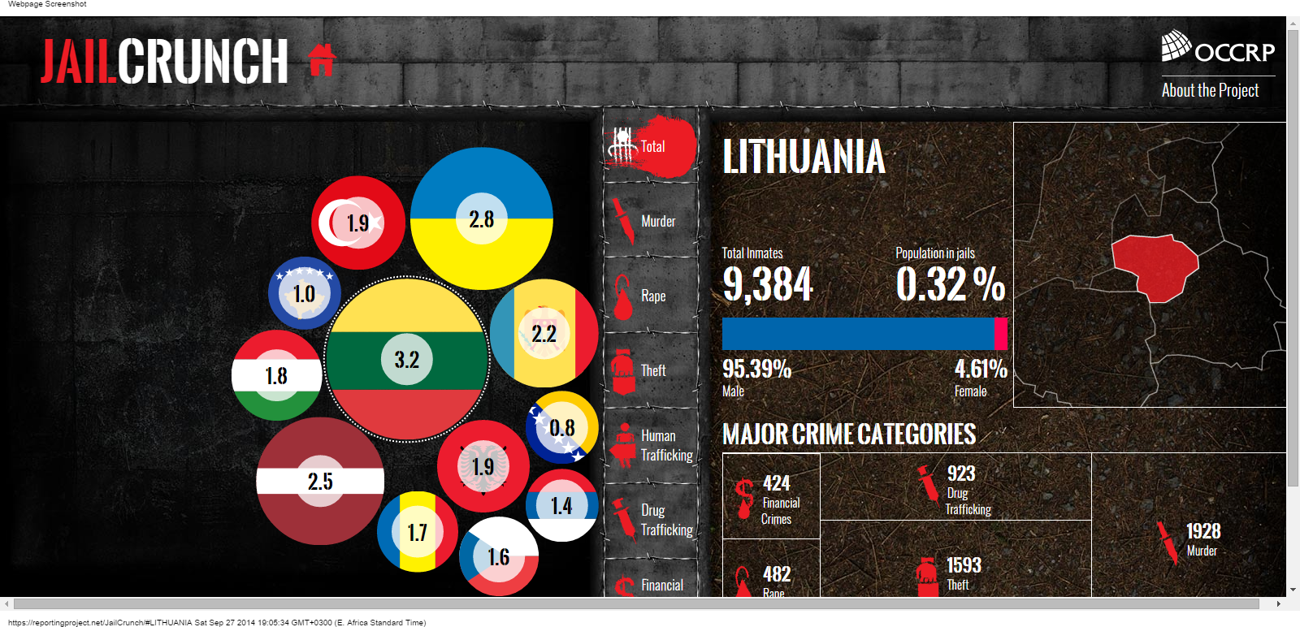
Data Sources: Recurring Events
Jail Crunch: Organized Crime and Corruption Reporting Project visualized crime rates by type of crime for Eastern Europe.

Slide 10
Exercise
What would your news angle be if you receive a report of monthly crime rates in Kabul?
Type of crime
Location
Data and time

Slide 11
Data Sources
Data Sources: recurring events
Governance & Security Indicators
Economic Indicators & Budgets
Education Indicators
Human rights & Equality Indicators
Environmental Indicators
Health Indicators

Slide 12
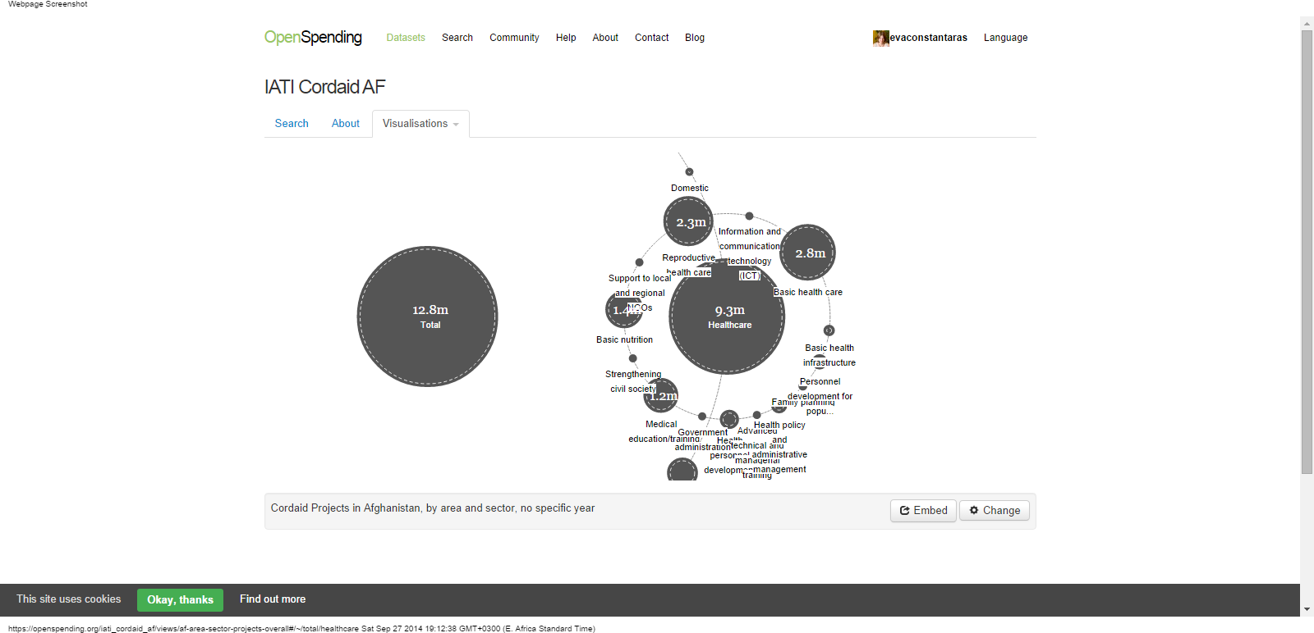
Data Sources: Recurring Events
CordAid Afghanistan Health: A sector breakdown of all health projects funded by the Catholic Organization for Relief and Development.

Slide 13
Exercise
How could you write a story about economics and budgets?
Annual budget
GDP
Donor aid

Slide 14
Data Sources
Data Sources: recurring events
Governance & Security Indicators
Economic Indicators & Budgets
Education Indicators
Human rights & Equality Indicators
Environmental Indicators
Health Indicators

Slide 15
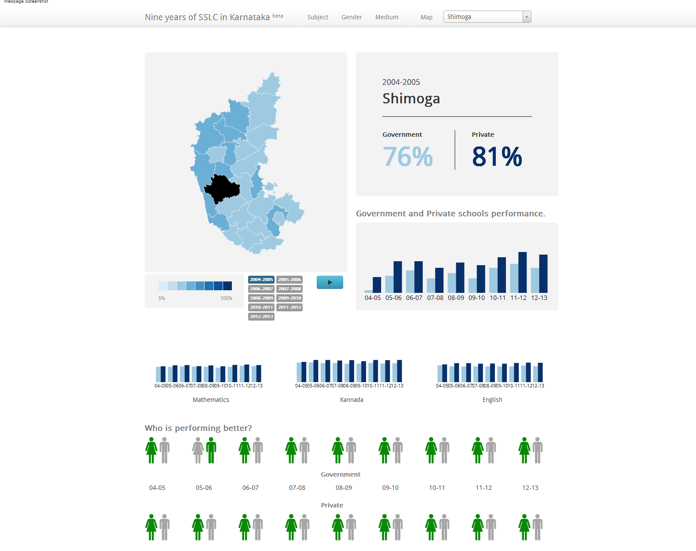
Data sources: Recurring Events
India school performance: District by district breakdown of private and public school performance by subject, gender and year.

Slide 16
Exercise
How could you write a story about education data?
School performance
Student-teacher ratio
School completion rates

Slide 17
Data Sources
Data Sources: recurring events
Governance & Security Indicators
Economic Indicators & Budgets
Education Indicators
Human rights & Equality Indicators
Environmental Indicators
Health Indicators

Slide 18
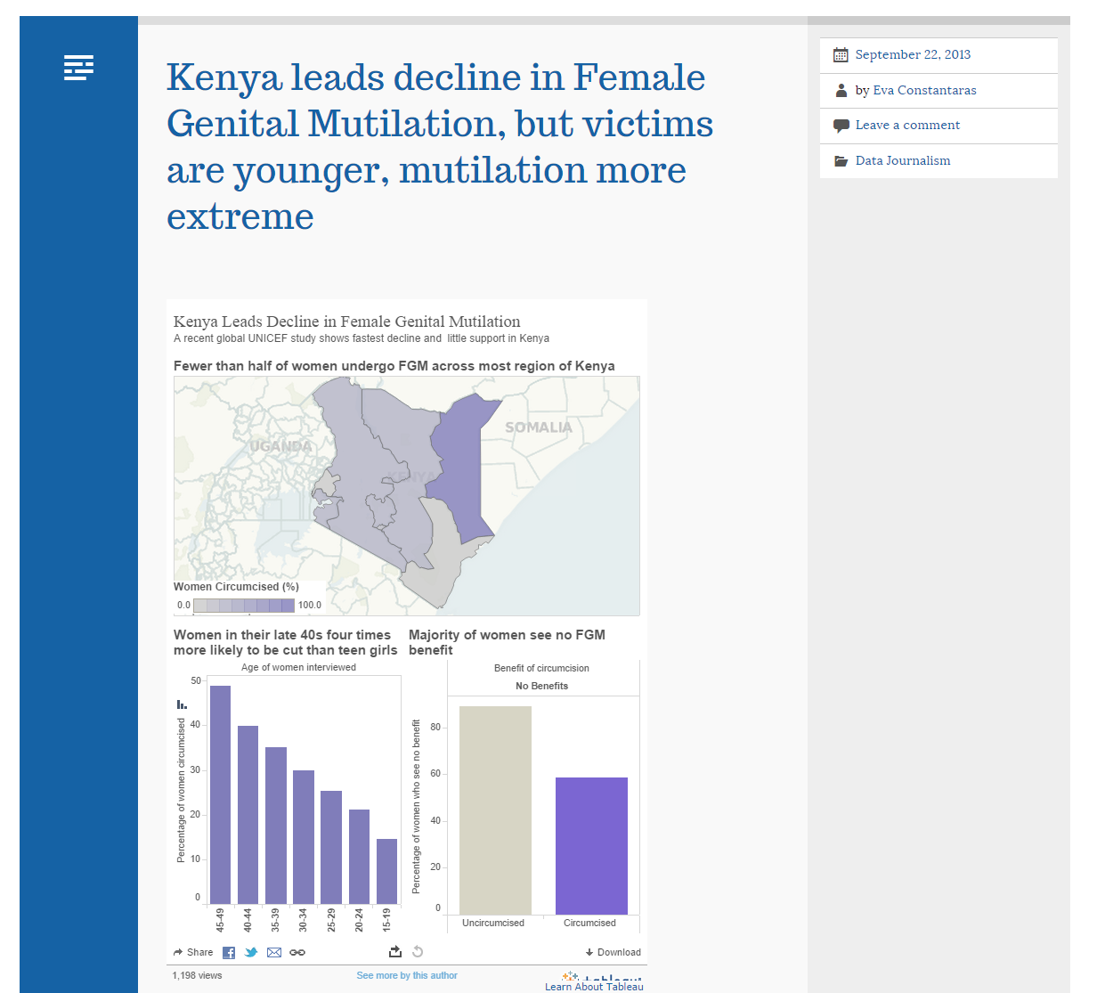
Data sources: Recurring Events
Kenya leads decline in FGM: Internews reports on the decline and remaining challenges to eliminate FGM based on UNICEF report.

Slide 19
Exercise
How could you write a story about human rights data?
Violence against women
Police abuse
Abuse of children

Slide 20
Data Sources
Data Sources: recurring events
Governance & Security Indicators
Economic Indicators & Budgets
Education Indicators
Human rights & Equality Indicators
Environmental Indicators
Health Indicators

Slide 21
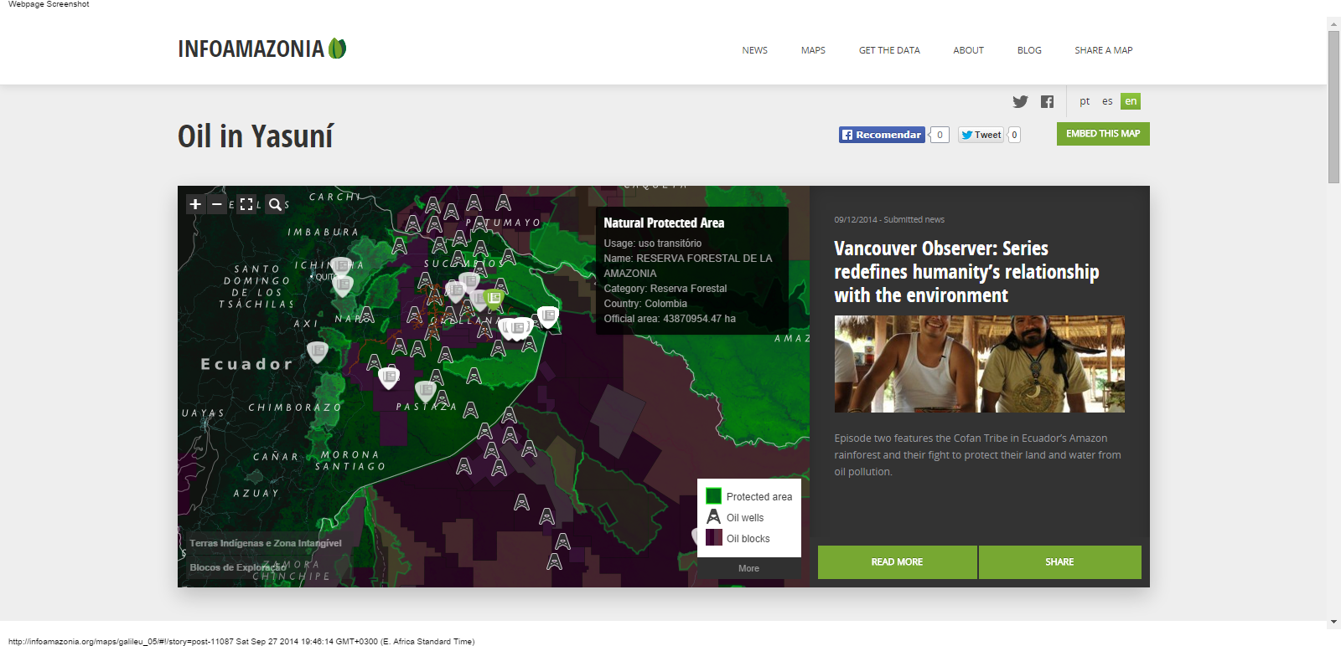
Data sources: Recurring Events
Infoamazonia: Maps of protected areas, oil wells and oil block contracts show where illegal oil drilling is taking place.

Slide 22
Exercise
What story angles can you think of for environmental data?
Source of energy and fuel
Rates of agricultural production
Report on extractive industry potential

Slide 23
Data Sources
Data Sources: recurring events
Governance & Security Indicators
Economic Indicators & Budgets
Education Indicators
Human rights & Equality Indicators
Environmental Indicators
Health Indicators

Slide 24
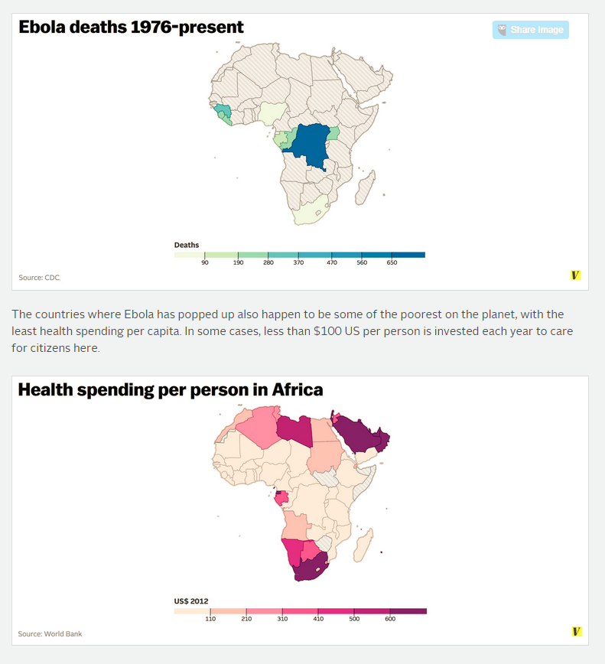
Sources of Data: Recurring Events
The Ebola outbreak's real cause: Letting industry drive the research agenda
: Vox shows that areas hardest hit by Ebola spend little on healthcare and little funds are invested in developing cures for neglected tropical diseases.

Slide 25
Exercise
How could you write a story about health data?
Number of hospitals
Life expectancy
Disease rates

Slide 26
Contents
The Data Journalism Process
Data sources: recurring events
Exercise
Data sources: sent or leaked data
Data sources: breaking news
Data sources: theories to be explored
Exercise
Summary & References

Slide 27
Exercise
How could these recurring reports be used in your reporting?
Corruption indicator data by year
Unemployment data by age group
Maternal and child mortality reports
Other reports, press releases and data sent to your media?

Slide 28
Contents
The Data Journalism Process
Data sources: recurring events
Exercise
Data sources: sent or leaked data
Data sources: breaking news
Data sources: theories to be explored
Exercise
Summary & References

Slide 29
Data Sources: Sent or Leaked Data
Wikileaks Afghan War Diary
The Afghan War documents leak is the disclosure of a collection of internal U.S. military logs of the War in Afghanistan, also called the Afghan War Diary, which were published by WikiLeaks on 25 July 2010. The logs consist of 91,731 documents, covering the period between January 2004 and December 2009.
The documents revealed information on the deaths of civilians, increased Taliban attacks, and involvement by Pakistan and Iran in the insurgency.
The New York Times, the Guardian and Der Spiegal received advanced copies of the logs.

Slide 30
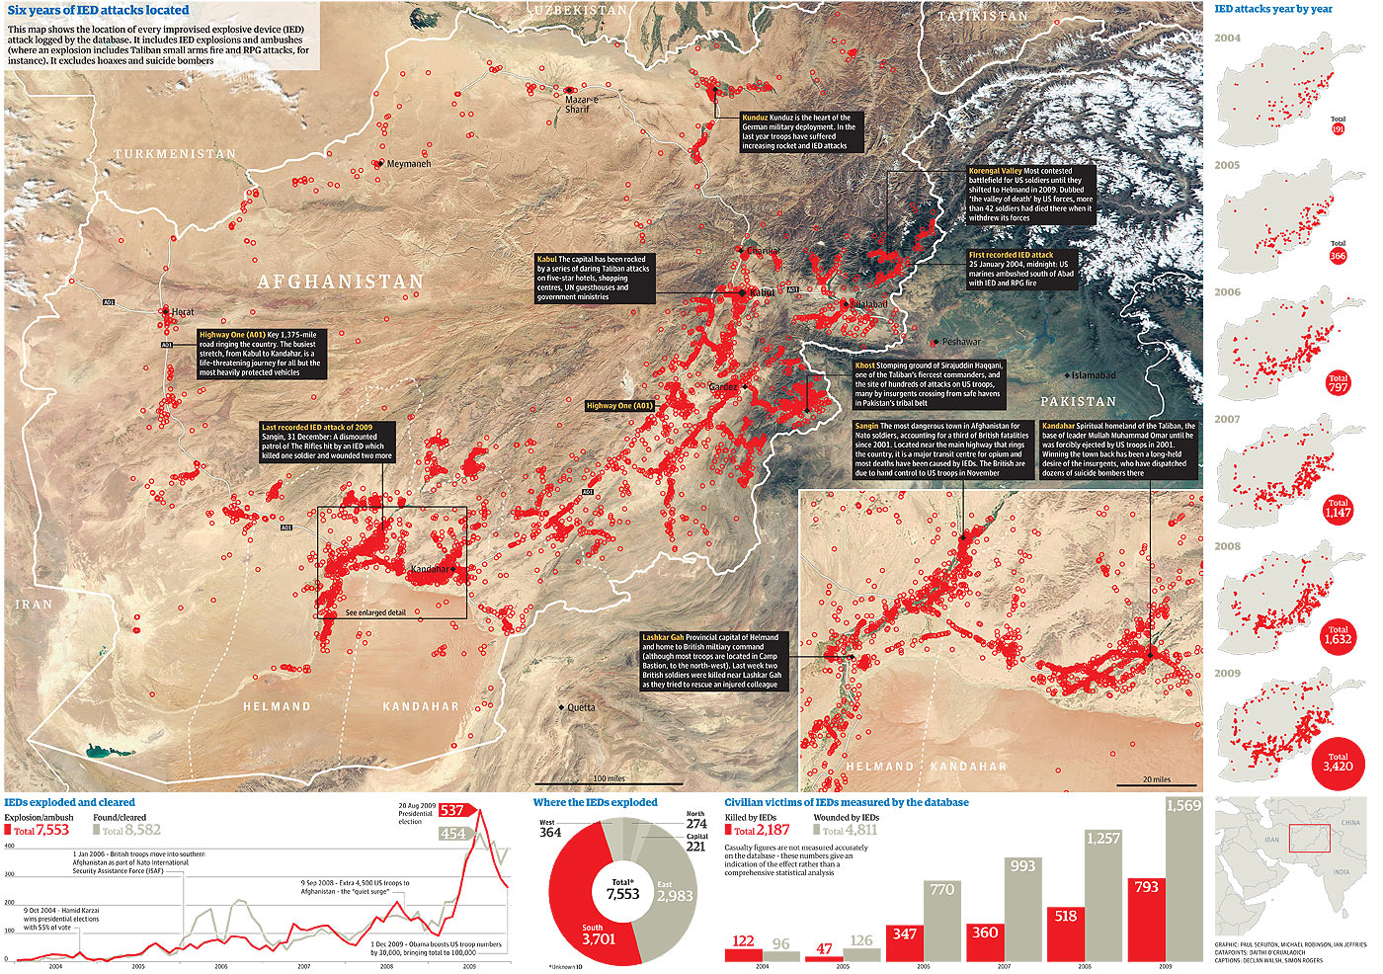
Data Sources: Sent or Leaked Data
Afghanistan The War Logs: The Guardian’s site explaining the human cost of war.

Slide 31
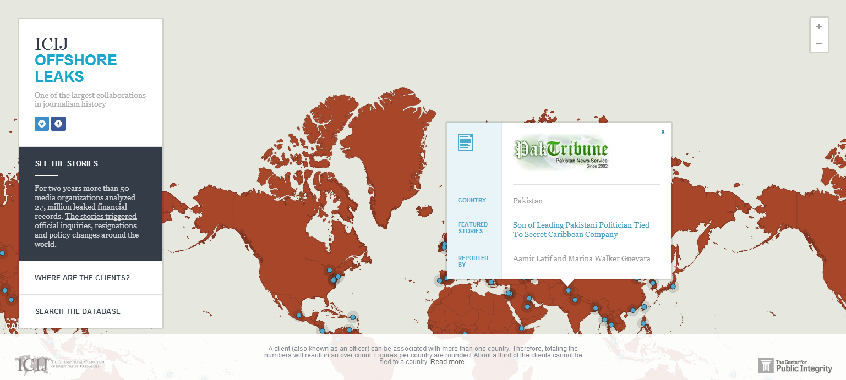
Data sources: sent or leaked data
Offshore Leaks: A leaked hard drive of 2.5 million documents about offshore bank accounts to the International Consortium of Investigative Journalists

Slide 32
Contents
The Data Journalism Process
Data sources: recurring events
Exercise
Data sources: sent or leaked data
Data sources: breaking news
Data sources: theories to be explored
Exercise
Summary & References

Slide 33
Data Sources: Breaking News
Data collection:
Crowd-sourcing via Ushahidi-type platforms
Citizen media contributions
Sensor data for environmental catstrophes
Risks:
Selection bias
Verification process
Context

Slide 34
Data Sources: Breaking News
Data collection:
Crowd-sourcing via Ushahidi-type platforms
Citizen media contributions
Sensor data for environmental catstrophes
Risks:
Selection bias
Verification process
Context

Slide 35
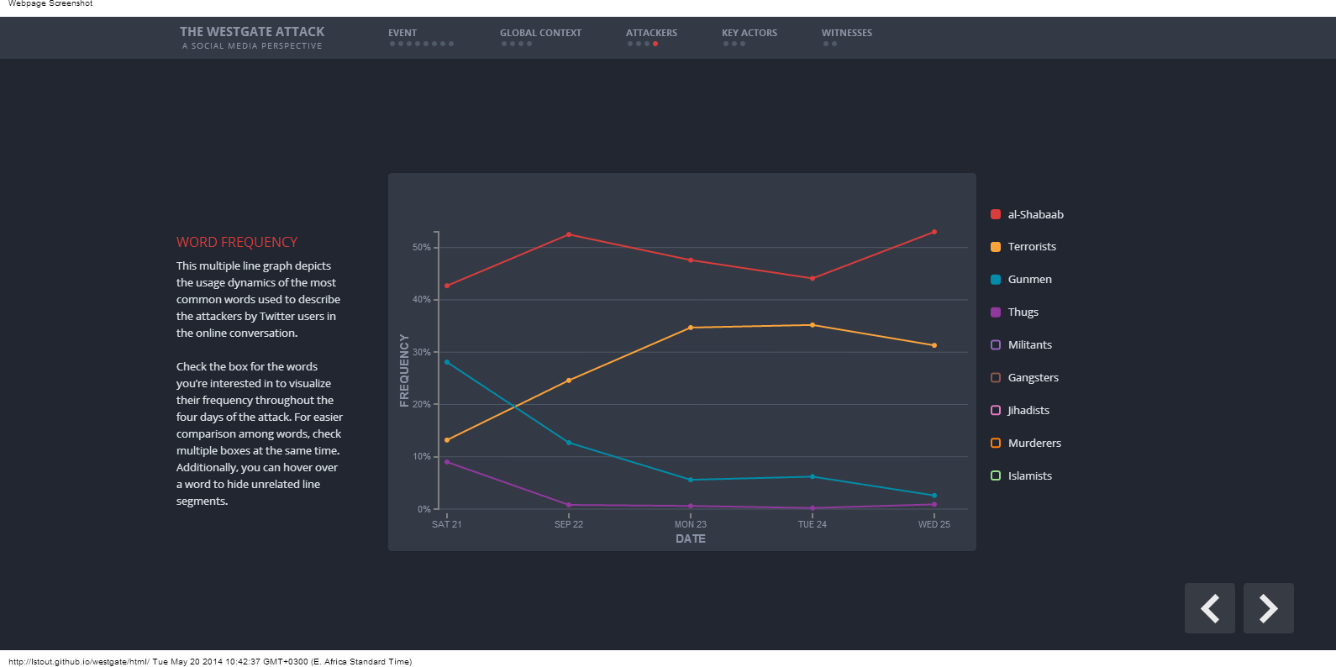
Data sources: breaking news
The Westgate Attack: A Social Media Perspective: An analysis of the events of Westgate driven by analysis of social media content.

Slide 36
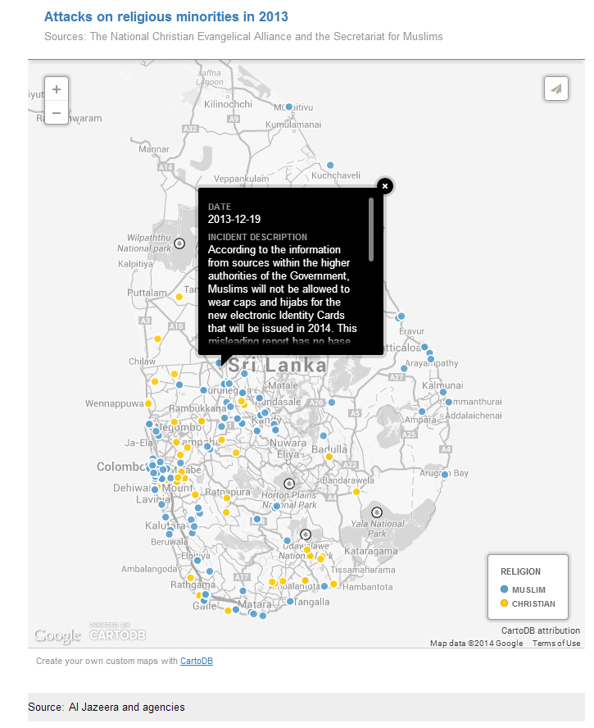
Muslims Killed in Sri Lanka Mob Attack, Al Jazeera.

Slide 37
Data Sources: Theories to be Explored
Global and open data catalogs
World Health Organization
United Nations
Population Reference Bureau
UNICEF Data
The Guardian's world government data portal
Google's public data directory
The data hub
DBPedia Datasets
Factual
Free GIS data
List of open data resources
Energy data repositories
World Research Institute
Data wrangling
Quora thread: "Where can I find large datasets open to the public?"
Directory of APIs
Infochimps
Datamarket
Offshore Leaks
Investigative Dashboard
Open Corporates
Natural Earth data
UNEP Data
Transparency International Corruption Index
Land Ownership Database
Gapminder World

Slide 38
Data Sources: Theories to be explored
Afghanistan Data Sources
International Security Assistance Force
Afghanistan Conflict Monitor
AfghanWire
The Afghanistan Analysts Network
Afghanistan Research and Evaluation Unit
International Crisis Group
Afghanistan Health Data
Ministry of Public Health
Health Policy Project
www.afga.org
Afghanistan Private Hospitals Association (APHA)
Afghan National Medicines Services Organization (ANMSO)
Afghan Midwifery Association (AMA)
Afghan Social Marketing Organization (ASMO)
Futures Group
HIV/AIDS Coordination Committee of Afghanistan (HACCA) Secretariat
Organization of Afghan Midwives (OAM)

Slide 39
Exercise
Read one of the two: Afghanistan WHO Profile
What story angles do you see in the data?
What other data would you look for to write your story?
Who would you interview for your story?

Slide 40
Contents
The Data Journalism Process
Data sources: recurring events
Exercise
Data sources: sent or leaked data
Data sources: breaking news
Data sources: theories to be explored
Exercise
Summary & References

Slide 41
Summary & Resources
Data sources include recurring events, sent or leaked data, breaking news and theories to be explored.
Data from these stories can be used to enrich traditional reporting, find new angles on old stories, uncover corruption or engage citizens in the reporting process.
Data sources are all around us: NGOs, research institutions, government and ordinary people.

Slide 42




Summary & Resources

